Slide 1
Topic 2 PSYCHOLOGICAL THEORIES OF THE ORIGINS OF AGGRESSION
FRUSTRATION MODEL

Slide 2
Frustration model of aggression
Frustration–aggression hypothesis was first formulated in opposition to the concept of drives: here, aggressive behavior is regarded as a situational process rather than evolutionary.

Slide 3
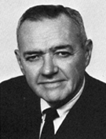
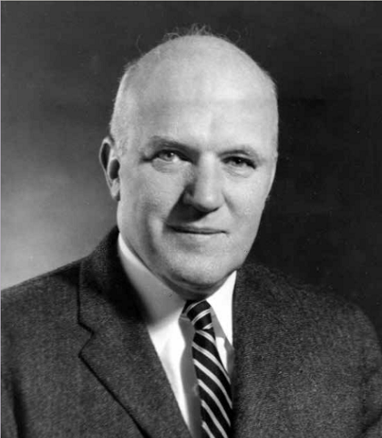
Frustration model of aggression 1. Orthodox approach
This line of research on human aggression was proposed by John Dollard and Neal Miller [1939].
According to their hypothesis, aggression is not an automatic urge, but a reaction to frustration, an attempt to overcome an obstacle on the way to satisfy the need or obtain a goal.
It is the experience of frustration that triggers the urge to act aggressively on the source of the frustration. This desire, in turn, is a catalyst for the manifestation of aggressive behavior.
John Dollard
Neal Miller

Slide 4
Frustration model of aggression 1. Orthodox approach
Aggression is a sure consequence of frustration.
Frustration in turn always precedes aggression. Thus frustration does not directly cause aggression, but only provokes it.
FRUSTRATION
AGGRESSION

Slide 5
Frustration model of aggression 1. Orthodox approach
The scheme "frustration - aggression" is based on four basic concepts: aggression, frustration, inhibition and displacement.
Aggression is regarded as intention to actively harm another person, as "an act whose goal-response is injury to an organism (or an organism surrogate)".
Frustration is defined as the "condition which exists when a goal-response suffers interference", when an obstacle appears and blocks a person’s effort to attain a goal. The level of frustration depends on how strong the motivation was, how significant the obstacle is and how many attempts were made before the frustration occured.

Slide 6
Frustration model of aggression 1. Orthodox approach
Inhibition is the tendency to restrict or curtail the action because of anticipated negative consequences.
Frustration theory separates the concepts of inducement to aggression and the actual act of aggression.
For example, if there is an urge for another reaction that will dominate the aggressive one, it will suppress the aggressive urge.
It is established that inhibition of any act of aggression is directly proportional to the strength of the expected punishment. In addition, inhibition of direct acts of aggression is almost always additional frustration. This additional frustration triggers aggression against the person who is perceived as the perpetrator of the inhibition and increases the urge for other forms of aggression. On the contrary, successful attempts to harm another person can weaken or completely eliminate the aggressive impulse.

Slide 7
Frustration model of aggression 1. Orthodox approach
Substitution (displacement) is the urge to express aggression directed at some other person rather than the true source of the frustration.
N. Е. Miller proposed a model meant to explain the occurence of displaced aggression [1948].
The aggressor's choice of victim is mostly determined by three factors:
a) the intensity of the inducement to aggression;
b) the significance of the factors inhibiting aggression;
c) the stimulus similarity between each potential victim and the frustrating figure.

Slide 8
Frustration model of aggression 1. Orthodox approach
Displaced aggression is more likely to be directed at the people for whom the inhibitory force is low, but whose stimulus similarity to the instigator is relatively high.
N. Е. Miller’s model of displaced aggression
FRUSTRATION
Overt aggression
Object that causes frustration
Object similar to the instigator
Displaced aggression
Intencity of the inducement to aggression
Intencity of the inhibition
Stimulus similarity

Slide 9
Frustration model of aggression 1. Orthodox approach
One of the concepts of the frustration theory of aggression is the catharsis effect, borrowed from psychoanalysis.
Catharsis (literally "purification“) is a process of releasing arousal or accumulated energy, leading to a reduction of stress level.
The essence of the concept is that physical or emotional expression of hostile tendencies results in temporary or prolonged relief, psychological balance and a decreased readiness for aggression.

Slide 10
Frustration model of aggression 2. Revisionist approach
Frustration theory has been thoroughly criticized, especially the hypothesis about the rigid interdetermination of the very scheme "frustration - aggression".
It was observed that people quite often experience frustration, but do not necessarily behave aggressively, and vice versa.
Proponents of the frustration theory agreed and somewhat modified their position.

Slide 11
Frustration model of aggression 2. Revisionist approach
N. Е. Miller was the first to respond to criticism [1941] and reformulated the hypothesys as following: frustration only creates the prerequisites to a number of different types of response, one of which is aggression.
FRUSTRATION
AGGRESSION
Other type of responce
Other type of responce

Slide 12
Frustration model of aggression 2. Revisionist approach
According to Miller, each person has a specific set of reactions to frustration, which can be arranged into a certain hierarchy of urges. The aggressive impulse can occupy any position in this hierarchy. If it is the strongest of the impulses, it will most likely motivate a person's actions. However if other impulses (perhaps incompatible with aggression) outweigh or even attenuate the urge for aggression, then the person will react accordingly, and possibly won’t behave aggressively at all or for some time.

Slide 13
Frustration model of aggression 2. Revisionist approach
Thus, two conclusions have been drawn:
If other types of reactions lead to a decrease in the initial frustration, then the intensity of the aggressive urge also decreases, so the aggression may not manifest itself;
If the first reaction didn't lead to a decrease in the initial frustration, then the non-aggressive impulse weakens or even disappears, and it’s place is taken the next dominant impulse in the hierarchy, which may be aggressive.

Slide 14
Frustration model of aggression 2. Revisionist approach
A certain pattern has been formulated:
the more often the non-aggressive impulses fade under the influence of continuing frustration, the more likely it is that the aggressive urge (initially inactive) becomes dominant and lead to an act of aggression as a responce to the frustration.
It is also noteworthy that each attenuated, unproductive reaction will intensify the frustration, as if summed up with subsequent reactions.
In other words, by the time the aggressive impulse will reach the top of hierarchy of reactions, the act of aggression will be more violent than it would be if committed immediately as the first reaction to the frustration.

Slide 15
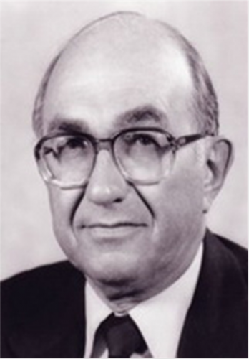
Frustration model of aggression 3. Leonard Berkowitz's frustration model.
Leonard Berkowitz is the author of another modification of frustration theory.
He implemented three significant amendments in the “frustration - aggression“ conceptual scheme:
а) Frustration doesn’t necessarily lead to aggressive actions but stimulates readiness to them;
b) Even in a state of readiness, aggression does not occur without proper conditions;
c) Resolving the frustrating situation through the aggressive actions cultivates a habit to resort to such actions.

Slide 16
Frustration model of aggression 3. Leonard Berkowitz's frustration model.
These amendments were based on the statement that frustration itself is an aversive(painful) stimulus that only provokes aggressive reactions, not leading to aggressive behavior directly. However, such a readiness to aggressive actions occurs only when there are certain impulses to aggression - some environmental incentives associated with some factors from past or present that provoke aggression.

Slide 17
Frustration model of aggression 3. Leonard Berkowitz's frustration model.
Aversive stimulus (pain, frustration, deprivation, discomfort etc.)
Readiness to aggressive action
Aggressive behaviour
Aggression incentives

Slide 18
Frustration model of aggression 3. Leonard Berkowitz's frustration model.
Leonard Berkowitz believed that stimuli start provoking aggression through a process similar to classical conditioning. A stimulus can acquire an aggressive meaning if it is related to positively reinforced aggression or associated with previously experienced discomfort or pain. If this connection becomes stable, then the stimulus becomes a signal to aggression. The role of aggression incentives can be played by both people (certain personality traits or behavior) and some characteristics of physical objects or environmental state.

Slide 19
Frustration model of aggression 3. Leonard Berkowitz's frustration model.
Leonard Berkowitz identified a wide range of negative conditions that can provoke aggression. In a variety of studies and experiments, it has been demonstrated that these conditions include:
excessively high temperature
cigarette smoke
disgusting odors
stuffiness
shortage of accommodation and overcrowding
stress caused by social tension(unemployment, inflation, security of residency etc.)
physical disabilities and so on.

Slide 20
Frustration model of aggression 4. Further development
In the course of its development, the frustration theory has undergone considerable changes and has divided into two relatively independent directions.
First approach
Proponents of the first approach remained adherents to the frustration-aggression hypothesis and continued to study mainly the conditions under which frustration leads to aggression, such as:
similarity or lack of similarity between the aggressor and the victim,
whether the aggression can be justified or not
level of aggression as a personality characteristic

Slide 21
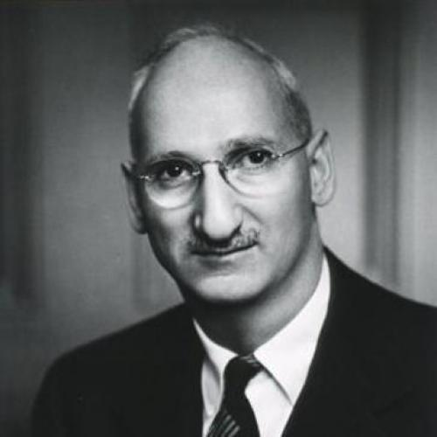
Frustration model of aggression 4. Further development
Second approach
Proponents of the second approach created their own conception of frustration, which is based on the analysis of frustration situations, classification and typology of reactions to frustration.
Saul Rosenzweig The author of the frustration theory, who developed the Rosenzweig Picture Frustration test.

Slide 22
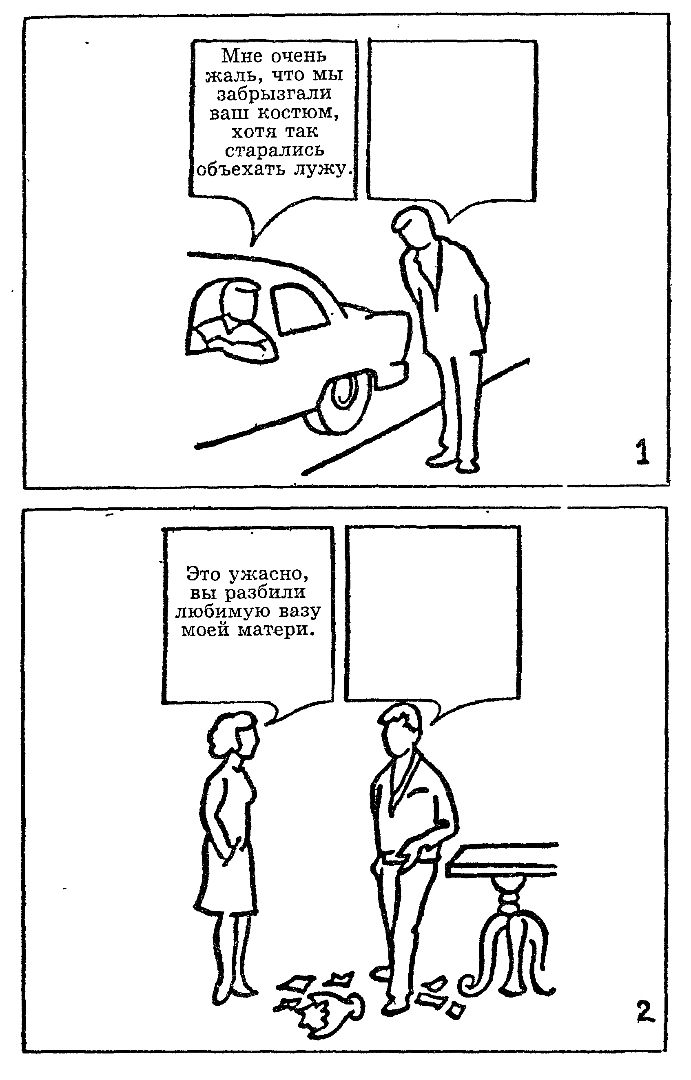
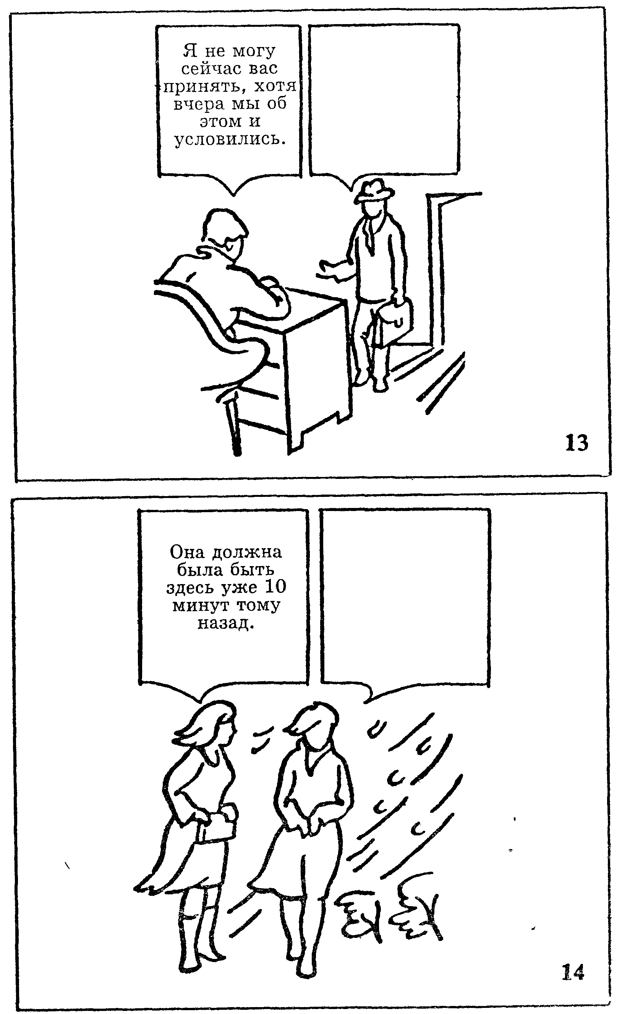
Frustration model of aggression 4. Further development
The Rosenzweig Picture Frustration test material

Slide 23
Frustration model of aggression 4. Further development
Saul Rosenzweig distinguishes three types of frustration causes:
privation - lack of necessary means to achieve a goal or meet a need;
deprivation - the loss of objects which were previously used to fulfill a need;
conflict - the simultaneous existence of two incompatible urges, ambivalent feelings or attitudes.

Slide 24
Frustration model of aggression 4. Further development
The results of Rosenzweig’s experimental research show the difference between the following directions of reactions to frustration:
external (extrapunitive) orientation, characterized by an overt manifestation of aggression, referring to impersonal circumstances, objects or the social environment;
internal (intrapunitive) orientation, characterized by open accusations or demands addressed to the self;
non-subjective (impunitive) orientation, characterized by the lack of aggression, accusations, demands and by the denial of a problem, conflict, someone's guilt or responsibility. It is also often characterized by an expression of hope for a favorable resolution of the conflict.

Slide 25
Frustration model of aggression 4. Further development
Saul Rosenzweig distinguishes the following types of reactions:
Obstacle-dominant (fixation of attention on an obstacle, stressor, instigator – on the phenomenon or a subject which creates a critical situation);
Ego-defensive (self-justification, bringing arguments in one's own defense, accusing another in order to deflect punishment from oneself, etc.)
Need-persistive (not withdrawal from the situation, but stubborn attempts to resolve it in some way, the desire to bring the situation to an end, the search for a way out, a constructive solution, etc.).

Slide 26
Frustration model of aggression 4. Further development
As a result of the research, aggression began to be considered not only as one of the possible ways out of frustrating sutuation.
The researchers concluded that frustrated personality reacts with a whole complex of defensive reactions, one of which plays the leading role. For example, in some cases, a person reacts to frustration with withdrawal, accompanied by aggressiveness that does not manifest itself directly.

Slide 27
Frustration model of aggression 4. Further development
In his later works L. Berkowitz reconsidered his idea of aggression determination by certain stimuli. He came to the conclusion that the incentives to aggression are not a necessary premise for the occurrence of aggressive reaction at all.
In the newest edition of his theory L. Berkowitz focused on the emotional and cognitive processes and their role in the occurrence of aggressive reaction.

Slide 28
Frustration model of aggression 4. Further development
L. Berkowitz proposed the Cognitive Neoassociationistic model of aggression:
Frustration and other aversive stimuli provoke aggressive reactions by forming negative affect.
The obstacles provoke aggression only insofar as they create negative affect.
Frustration will not provoke aggression if it is not experienced as an unpleasant event.
In other words, the degree of aversiveness of the frustration situation must be sufficient to trigger negative emotions. If frustration does not lead to negative experience, the aggression does not occur. On the other hand, psychological processes, including reflection on the past experience (cognitive process), will influence the actual behavior: the way a person themself interprets the negative impact determines their reaction to this impact.

Slide 29
Frustration model of aggression 4. Further development
According to Berkowitz, facing an unfavorable situation is first experienced by the individual as an undifferentiated negative emotional state. This reaction causes two responce tendencies: fight (to destroy the cause of displeasure) or flight (to leave a dangerous or unpleasant situation). Fighting is associated with aggressive thoughts, memories and behavioral manifestations; escape is associated with avoidance reactions. However, the tendency to flee can also be based on the urge to harm someone.

Slide 30
Frustration model of aggression 4. Further development
According to Berkowitz, fight or flight tendencies channel initially undifferentiated negative emotions into more specific categories of primal anger or primal fear.
To isolate primary feelings and derive more complex emotional states from them requires cognitive work including an assessment of the initial stimulus situation, potential consequences, memories of similar sutuations in the past, and social norms associated with the expression of emotions. The final emotional state is a combination of individual feelings, expressive motor reactions, thoughts and memories associated with each other. Since all the components of an emotional experience are related to each other, it is assumed that the activation of one component will trigger another one and so on. For example, memories of negative events can lead to aggressive thoughts and feelings increasing the possibility of aggressive behavior in a new situation or in relation to an object which is completely unrelated to the original event.

Slide 31
FRUSTRATION MODEL OF AGGRESSION
Thus,
Aggression is only one of the possible reactions to negative impacts. This means that aggression is not inevitable, but potentially possible type of human behavior that is activated or suppressed by emotional experience caused by an unpleasant situation.

